Slide 1
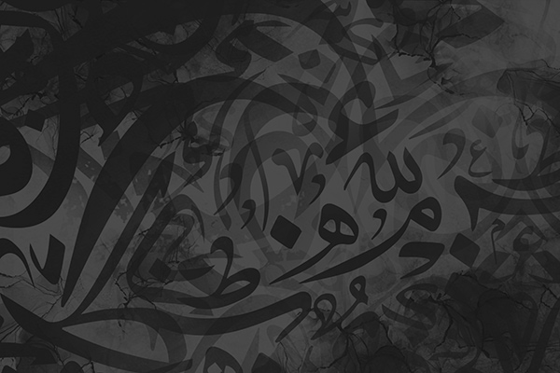


Tajdeed
TAJDEED
WEBSITE PROPOSAL

Slide 2
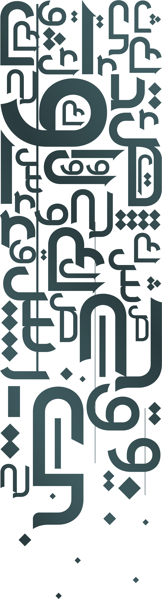

INTRODUCTION
Tajdeed: Renewal and Revitalisation of Arabic Calligraphy and Cultural Heritage
Tajdeed is a cultural project bridging the gap between tradition and modernity, introducing young Arab diaspora individuals in London to the valuable tradition of Arabic calligraphy through workshops and digital experiences.
The key platform is a website that provides learning.

Slide 3

USE CASE
The website is a platform that displays the various events and workshops that Tajdeed provides along with the merch that they can purchase.
Helps ease the user experience by being easily accessible, include, open for all and engaging.

Slide 4
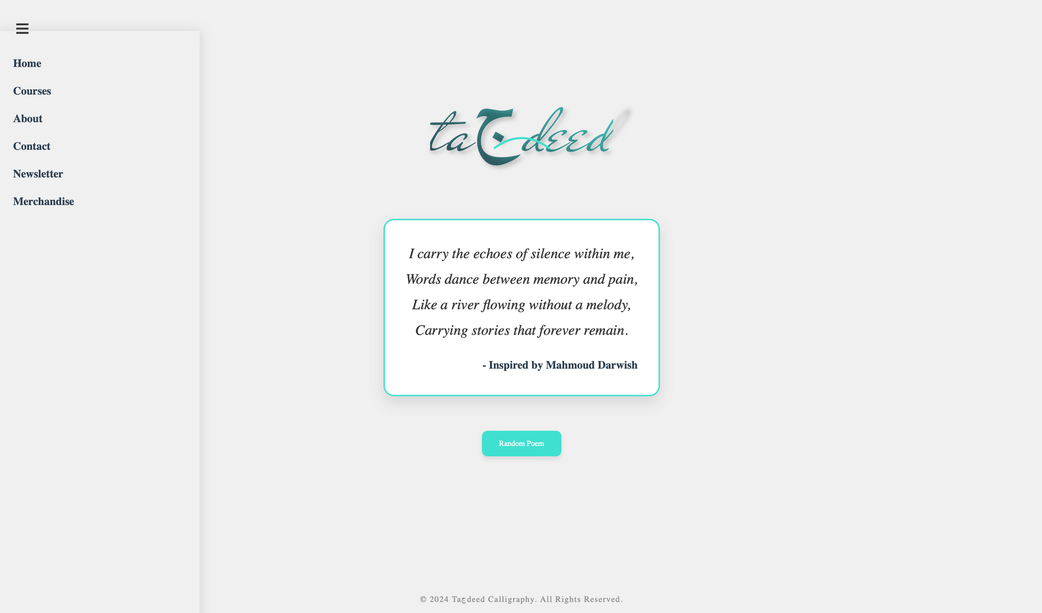

Slide 5

Side Menu
Select which part of the page you’d like to navigate to.

Slide 6
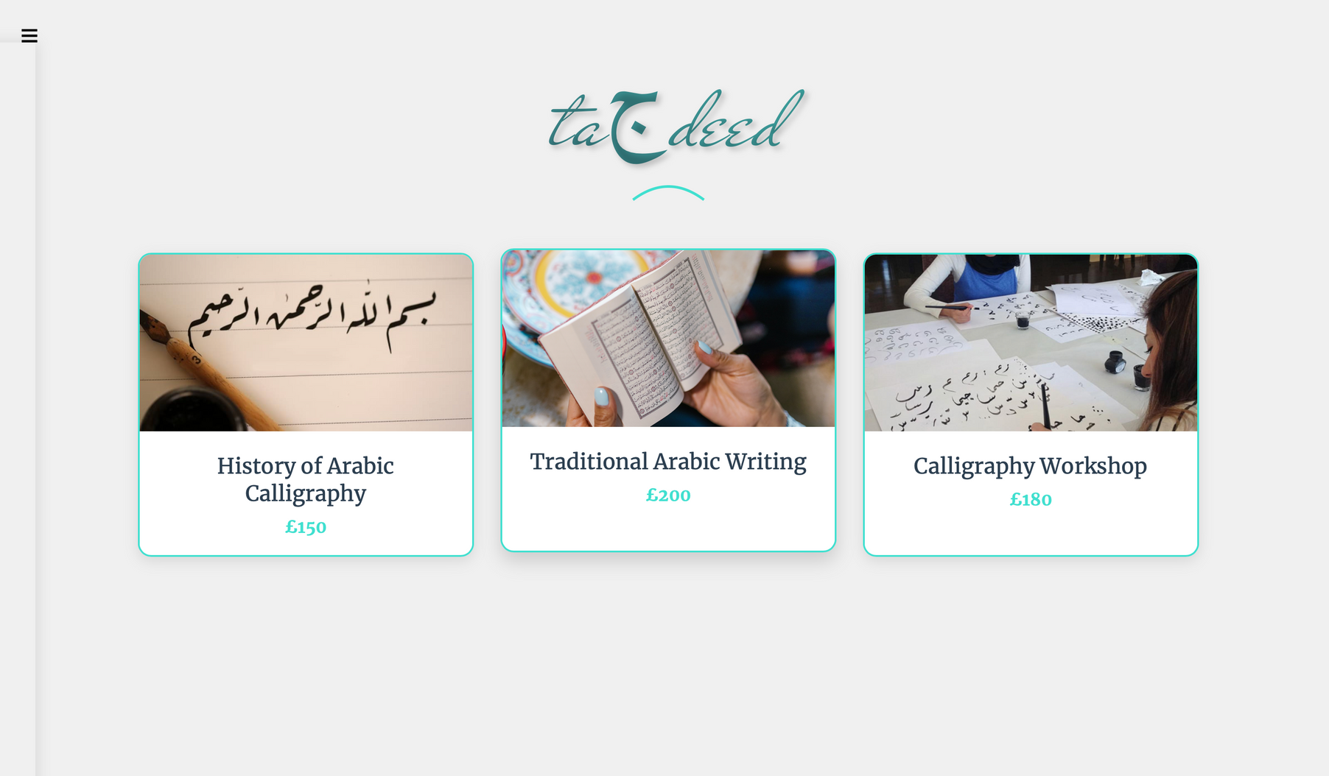

Slide 7
Courses
This page shows all available courses.

Slide 8
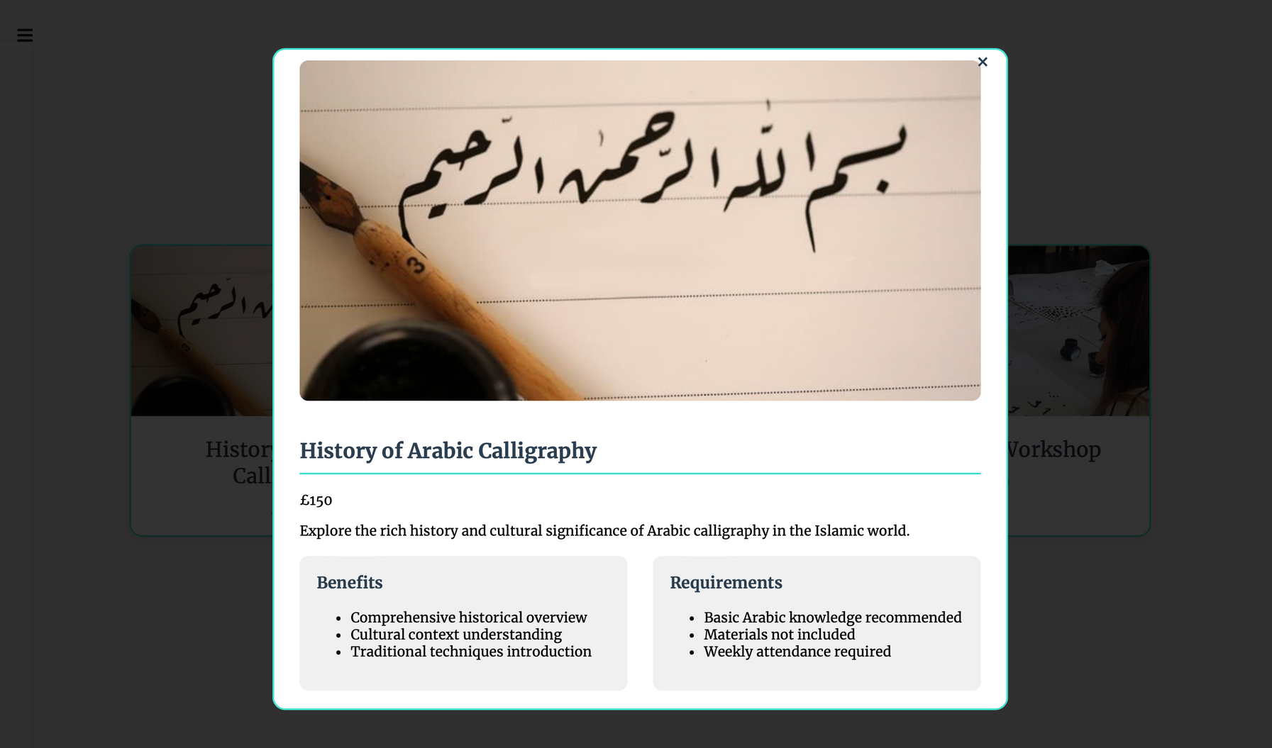

Slide 9
Courses
Each course page shows details about it, we have implanted
a custom LLM that creates bullet points for each new course added.

Slide 10
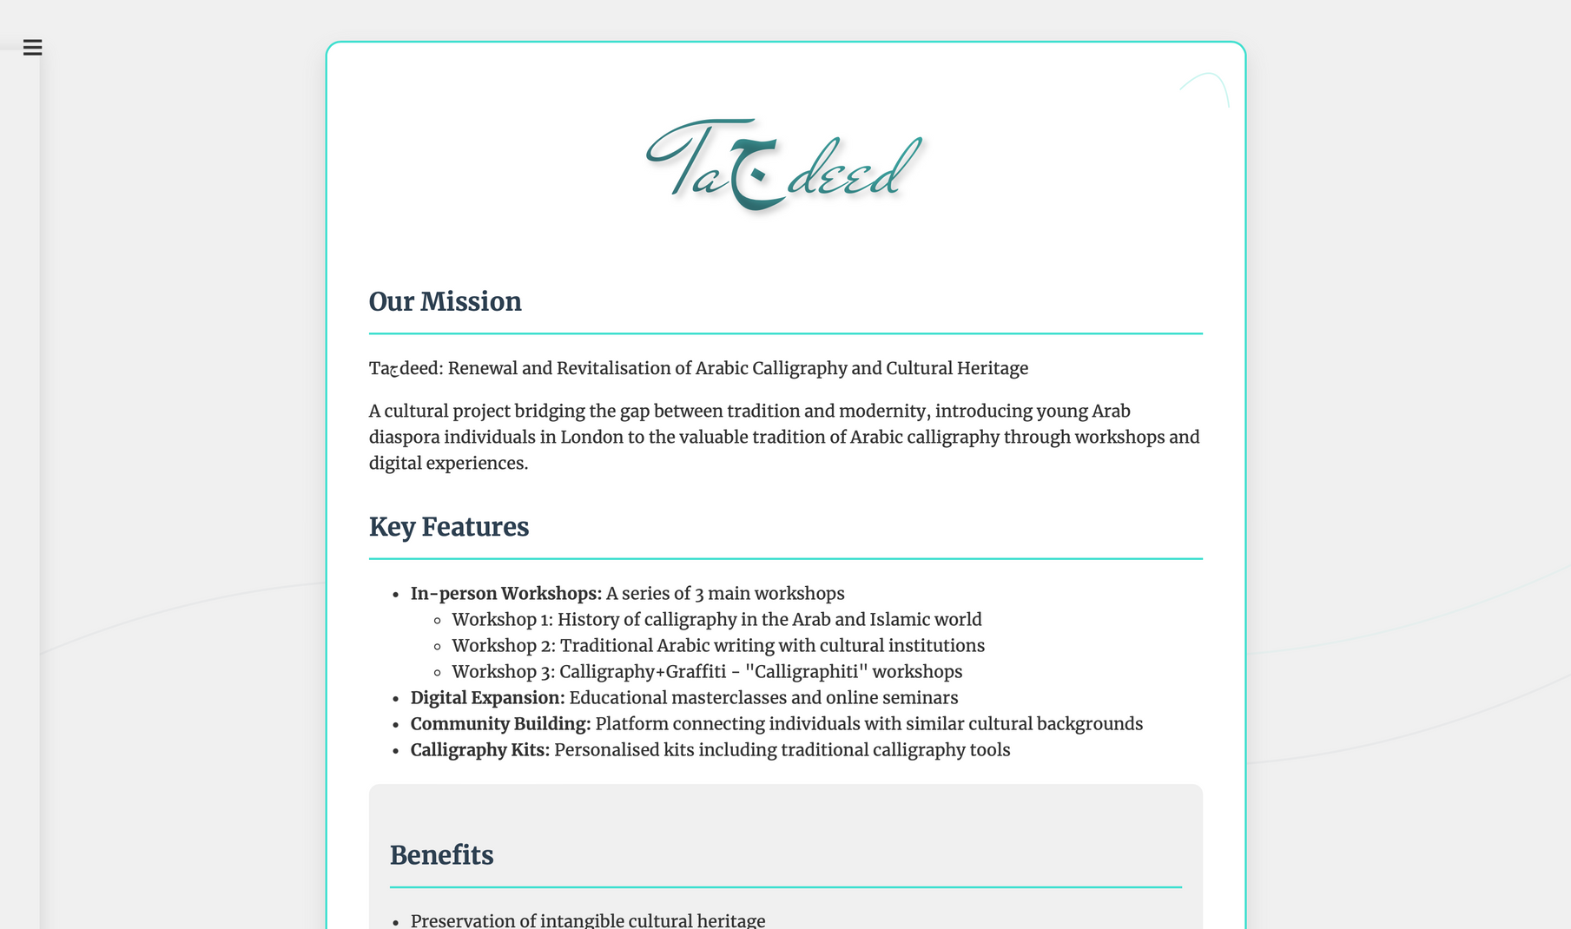

Slide 11
About Us
This page shows a blog about our project.

Slide 12
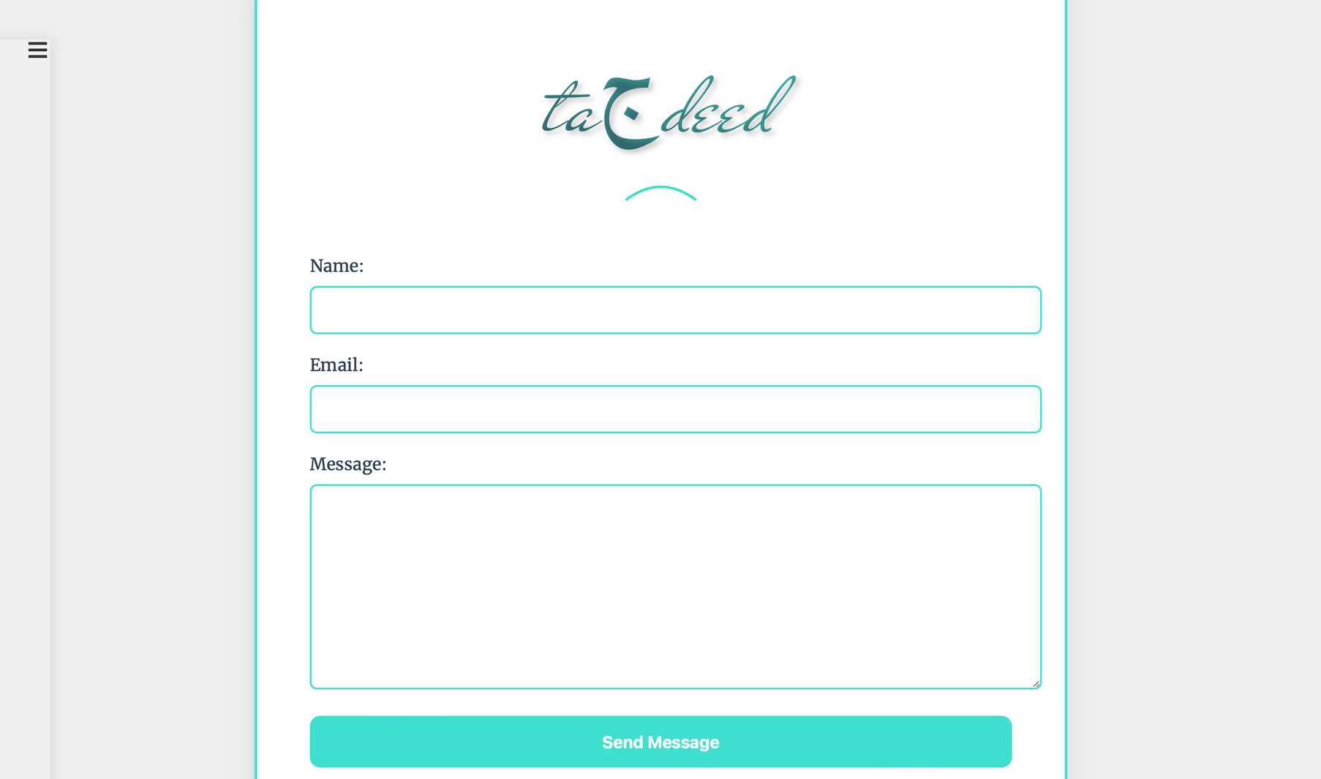

Slide 13
Contact
This page allows the
user to contact the team.

Slide 14
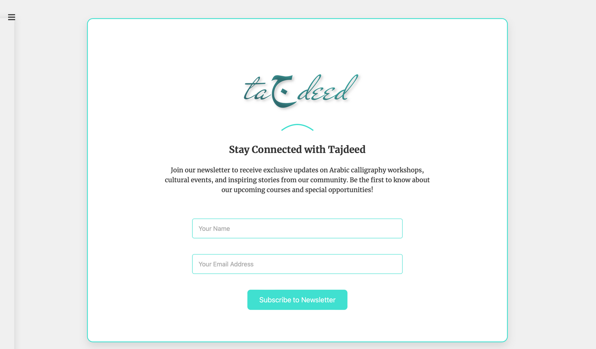

Slide 15
Newsletter
Each course page shows details about it, we have implanted
a custom LLM that creates bullet points
for each new course added.

Slide 16
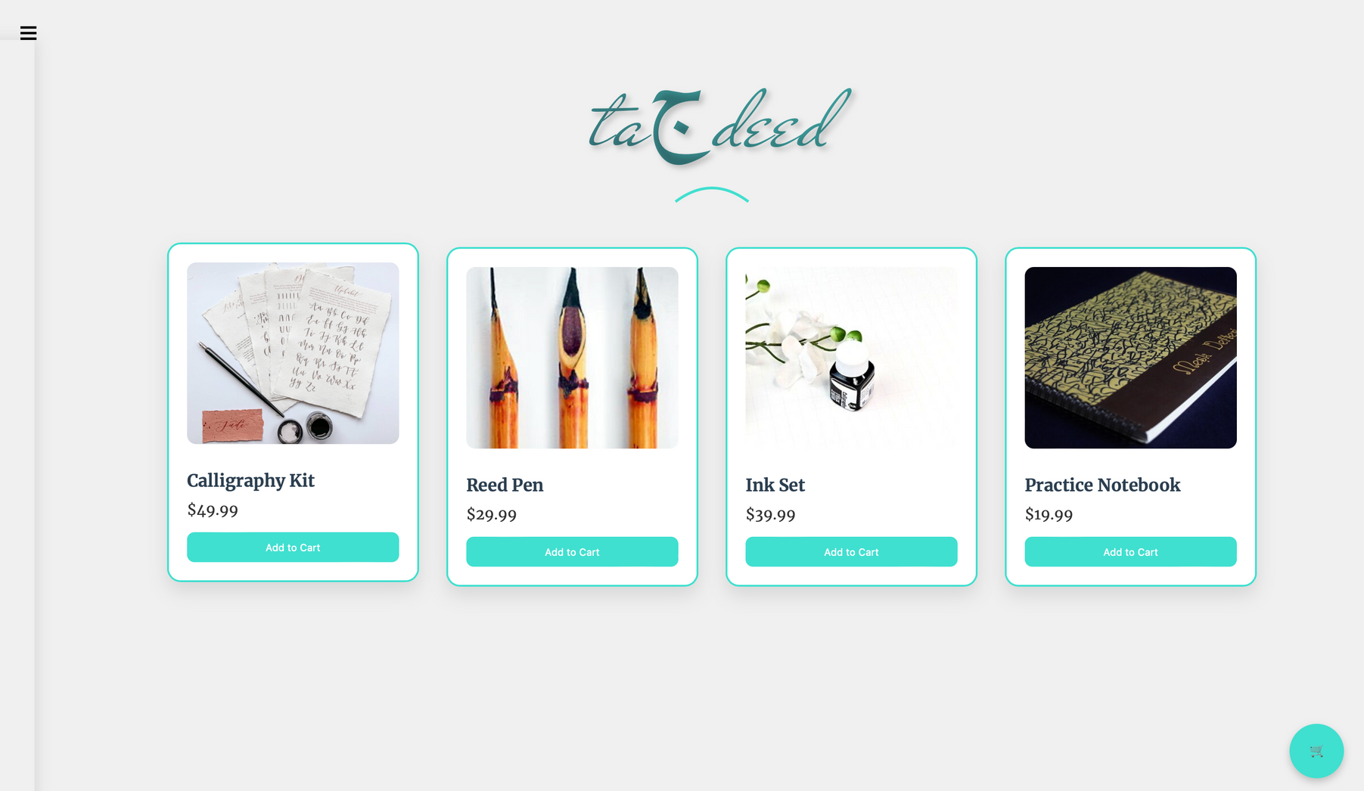

Slide 17
Merch
This page allows the user to buy merch through our store.

Slide 18
THANK YOU
for your time and attention

